Slide 1
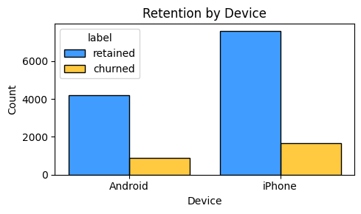
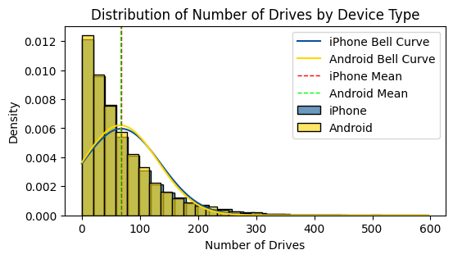
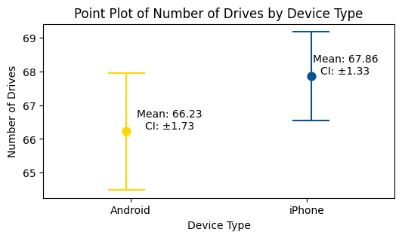
Title
Subtitle
The Waze leadership team wants to understand if there is a statistically significant difference in the mean number of drives between iPhone and Android users. Identifying any significant differences will help in tailoring user experiences and improving user retention.
To address this issue, the Waze data team conducted a statistical analysis involving:
Computing descriptive statistics to summarize user data.
Performing a two-sample t-test to compare the mean number of drives between iPhone and Android users.
Using a significance level of 5% to determine the statistical significance of the observed differences.
The results of the analysis will inform Waze’s strategies to enhance user experience and reduce churn. Understanding whether device type affects user engagement will help prioritize development efforts and resources.
The null hypothesis (H0): There is no difference in the average number of drives between iPhone users and Android users.
The alternative hypothesis (H1): There is a difference in the average number of drives between iPhone users and Android users.
The t-test result: t-statistic = 1.46, p-value = 0.143. Since the p-value (0.143) is greater than the significance level (0.05), we fail to reject the null hypothesis, indicating no statistically significant difference in the average number of drives between iPhone and Android users.
Both iPhone and Android users have similar driving patterns, suggesting that device type does not significantly influence user engagement in terms of the number of drives.
Additional factors influencing user churn should be investigated to develop effective retention strategies.

